Slide 1


Kivy Basics
Box Layout, Grid Layout, Text Input

Slide 2
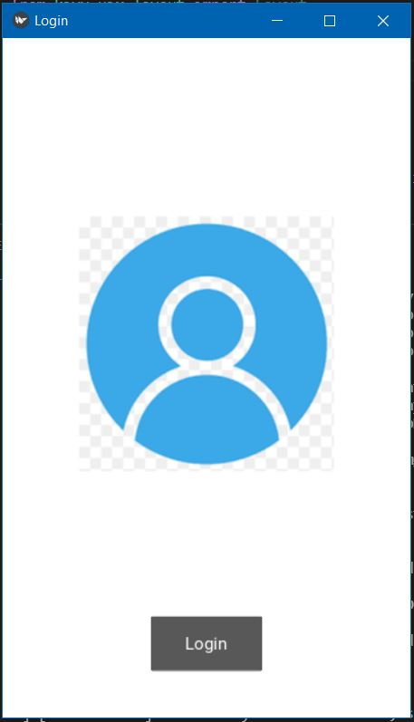
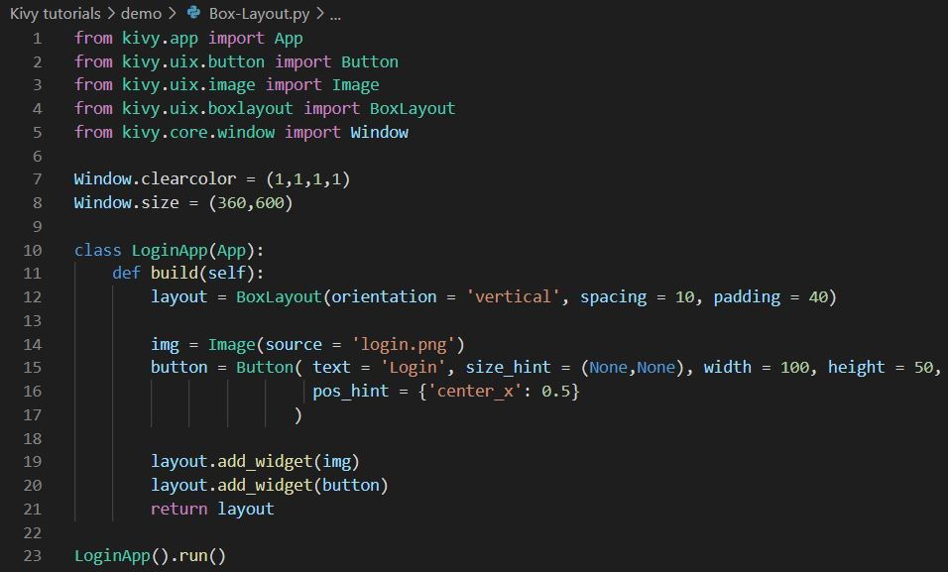
Box Layout
Import Box Layout--> from kivy.uix.boxlayout import BoxLayout

Slide 3
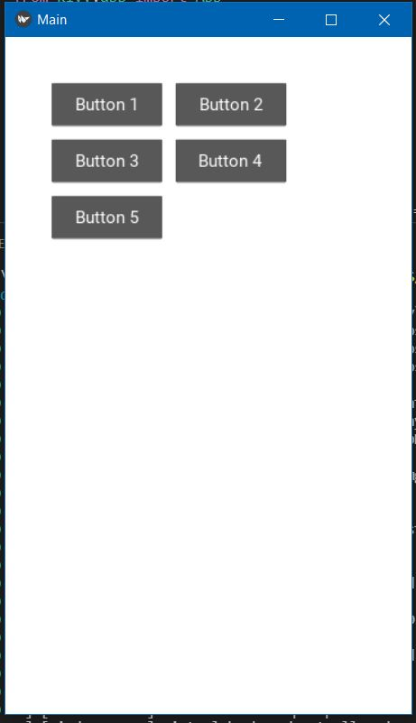
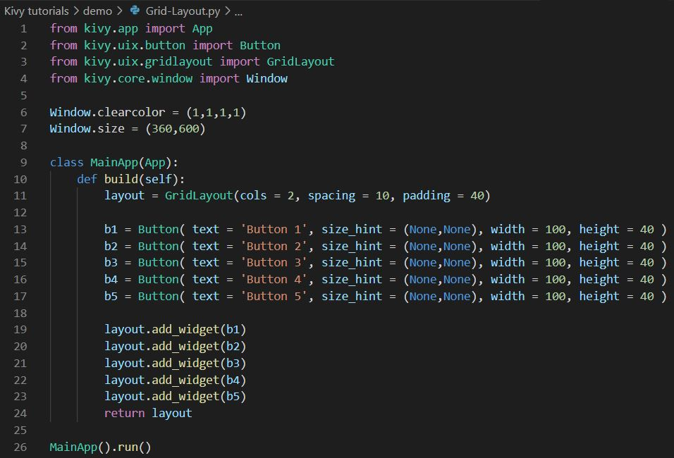
Grid Layout
Import Grid Layout--> from kivy.uix.gridlayout import GridLayout

Slide 4
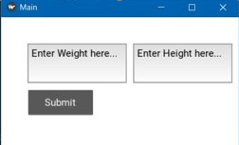
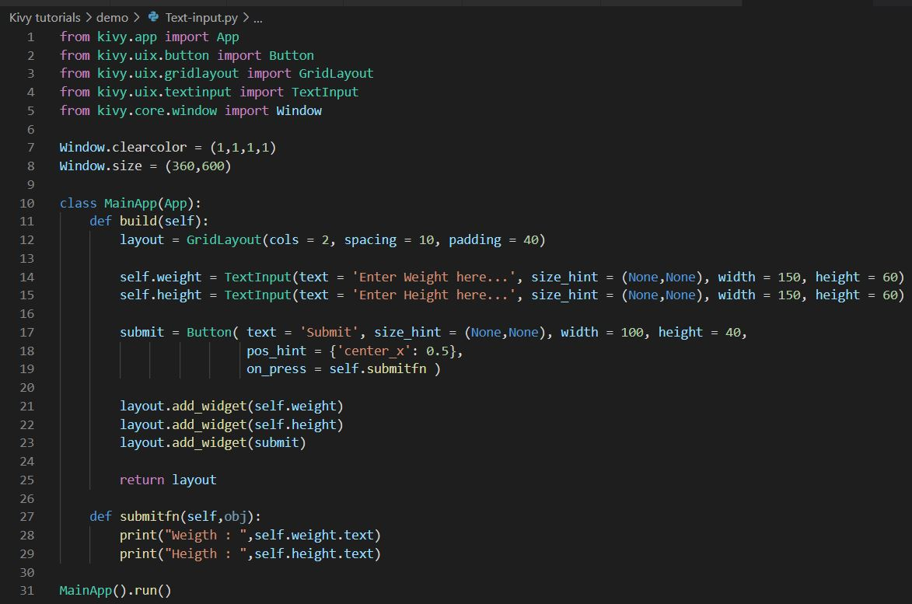
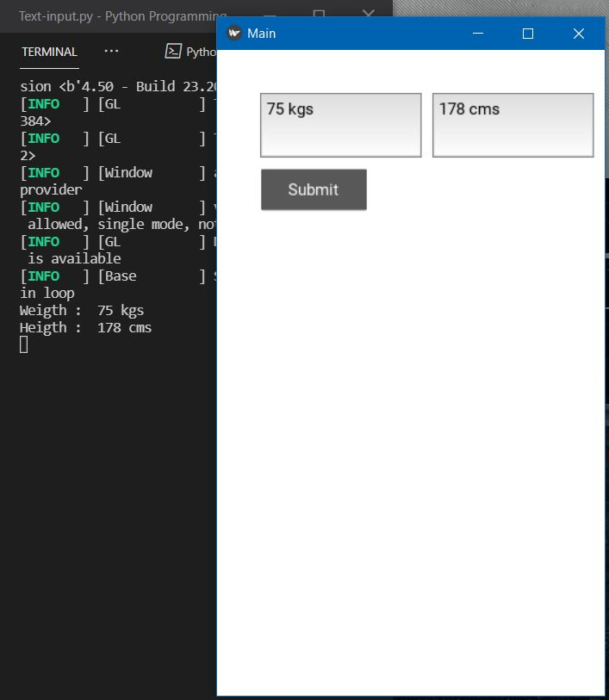
Text Input
Import Text Input --> from kivy.uix.textinput import TextInput

